Slide 1
HYDRO
DYNAMICS
By The Wallace High School

Slide 2
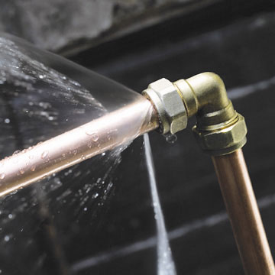
Water Wastage
150 litres a day per person.
3400 litres if you count water used in food.
An 8 minute shower uses 65 litres of water.
Wikipedia states an average bath uses 100 litres of water per use but waterwise states that a bath only uses 80 litres of water.

Slide 3
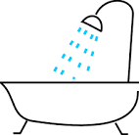
How we use our water
Toilet flushing 30%
Baths and taps 21%
Showers 12%
Clothes washing 13%
Washing up 8%
Outdoor 7%
Other 5%
Drinking 4%

Slide 4
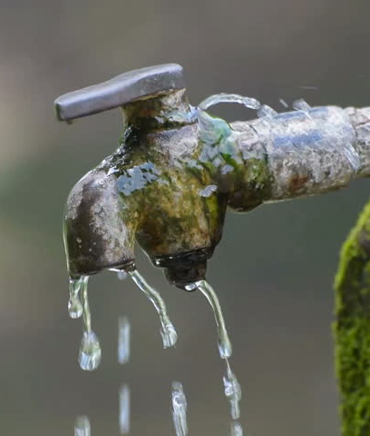
The Problem
The problem we have chosen to research is water wastage.
About 95 percent of the water entering our homes goes down the drain.
Running the tap while brushing your teeth can waste 4 gallons of water.

Slide 5
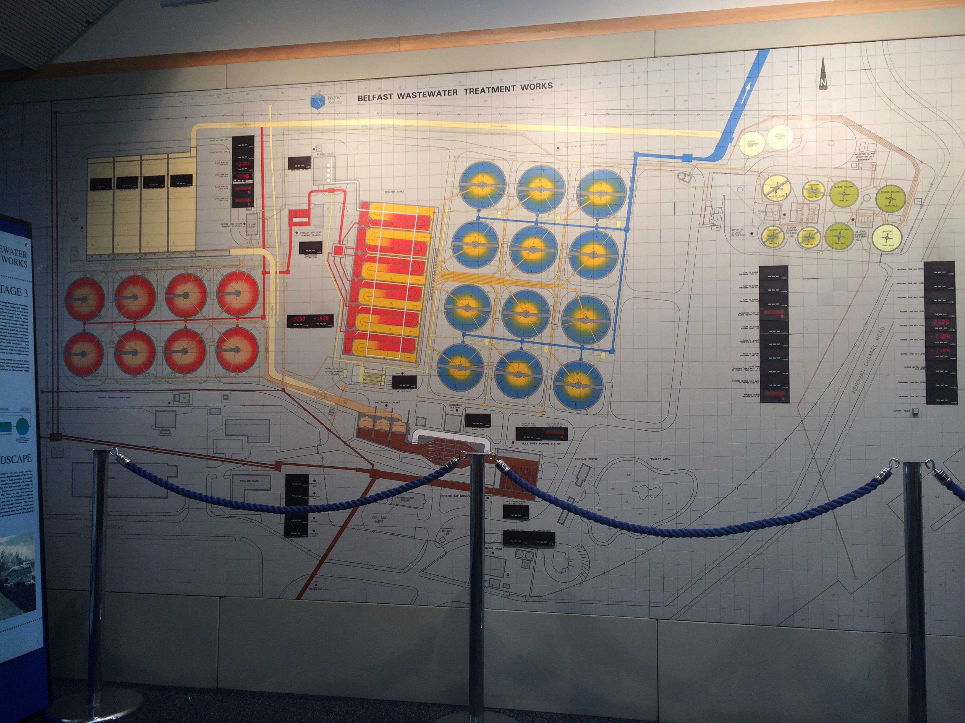
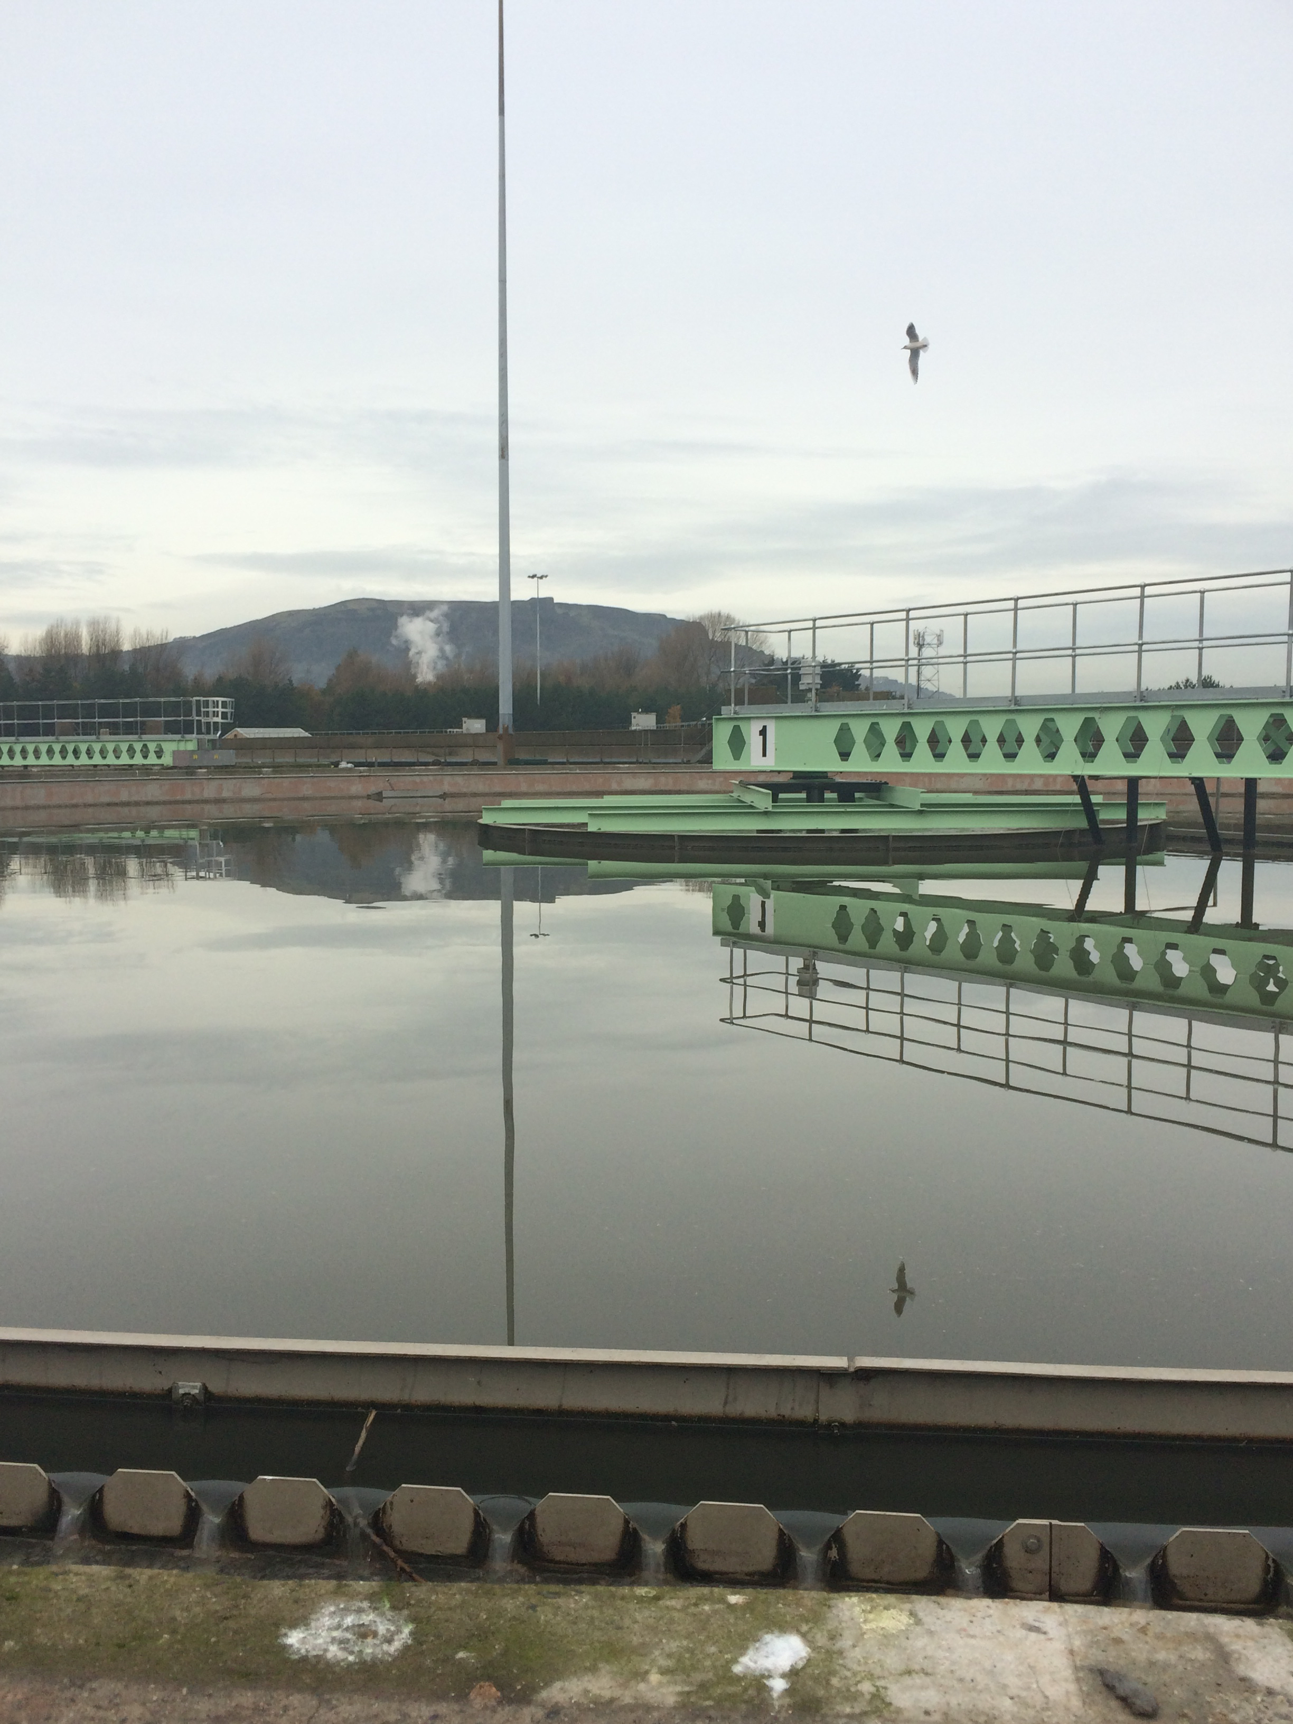
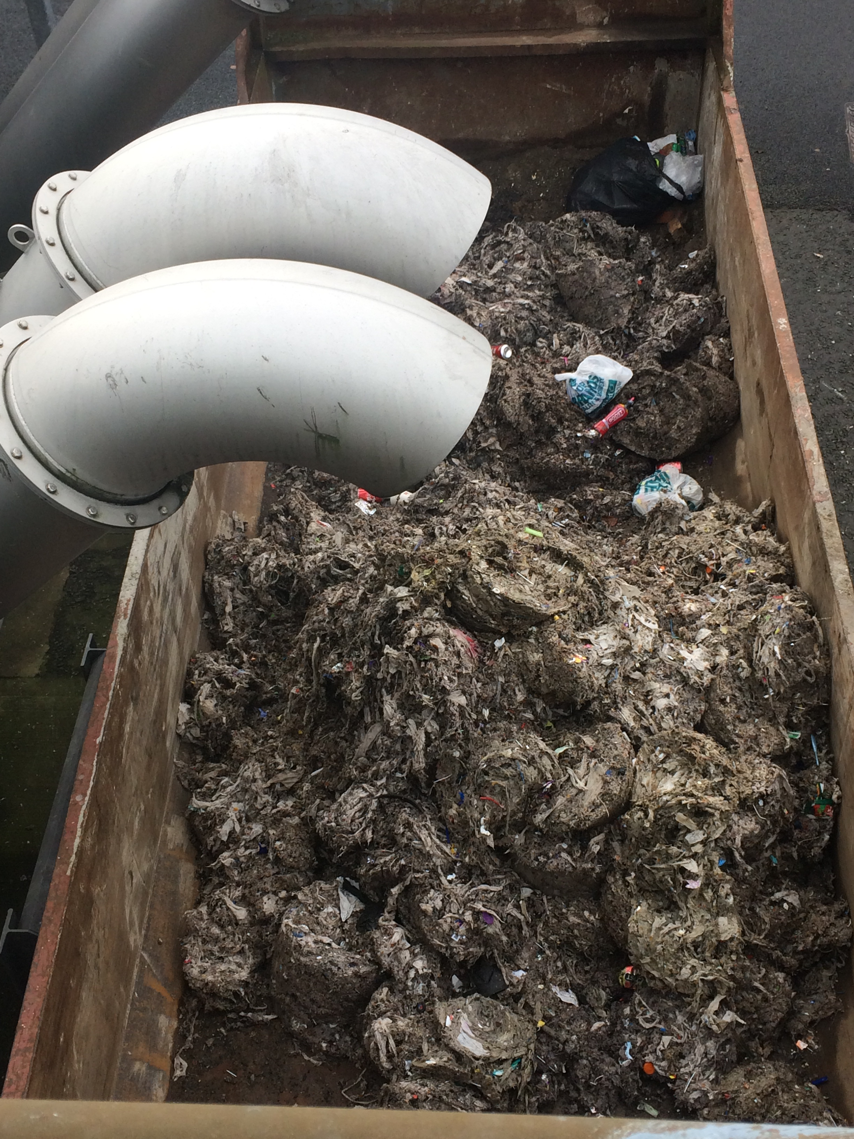
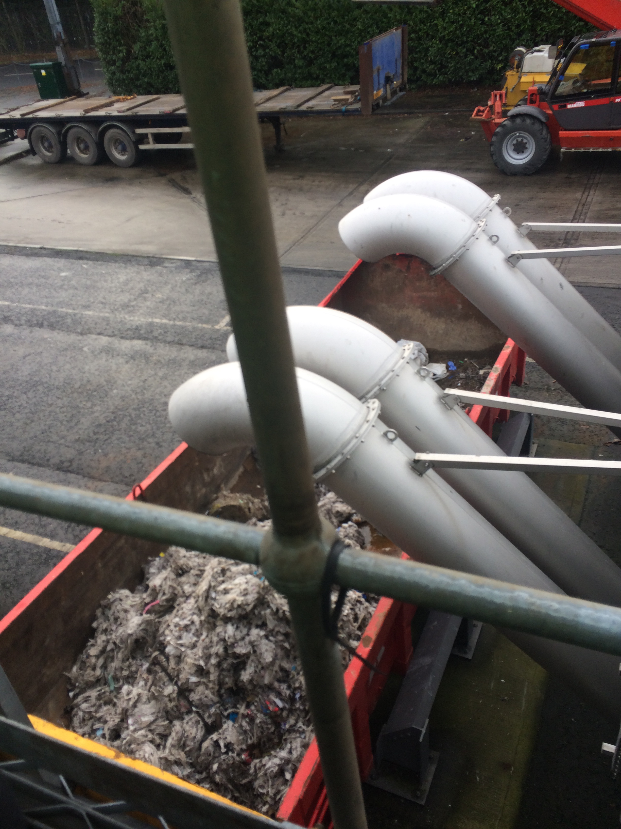
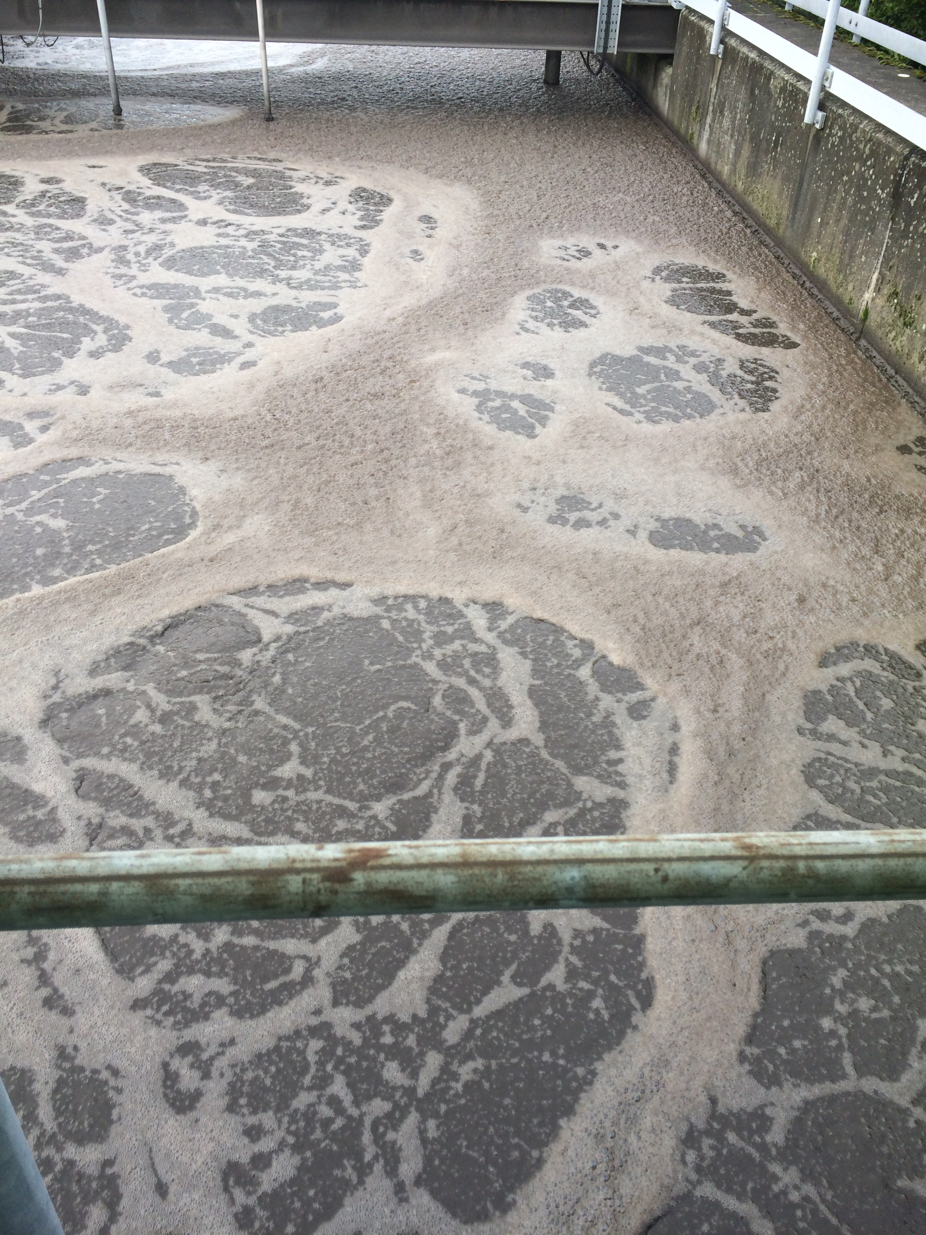
N.I Water
We visited N.I water to find out more information and figure out how to solve our problem.

Slide 6
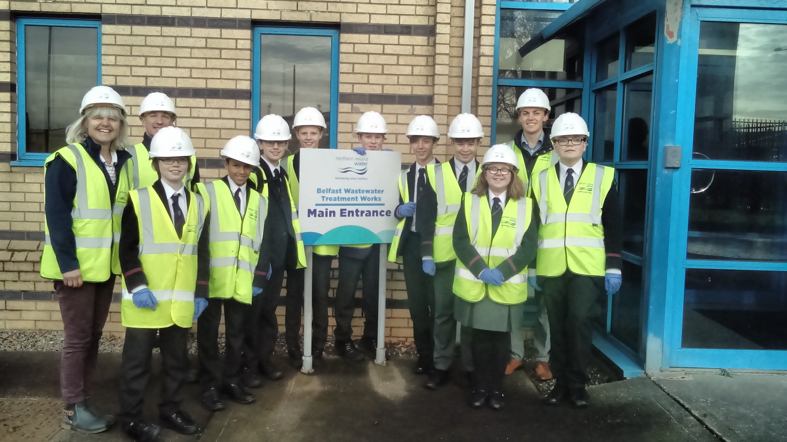
N.I Water
During our trip we found out some really interesting facts and good ideas to cut down on water wastage.
The workers at N.I Water were happy to help out as the less water we waste, the easier it is for workers all over Northern Ireland to treat the water.

Slide 7
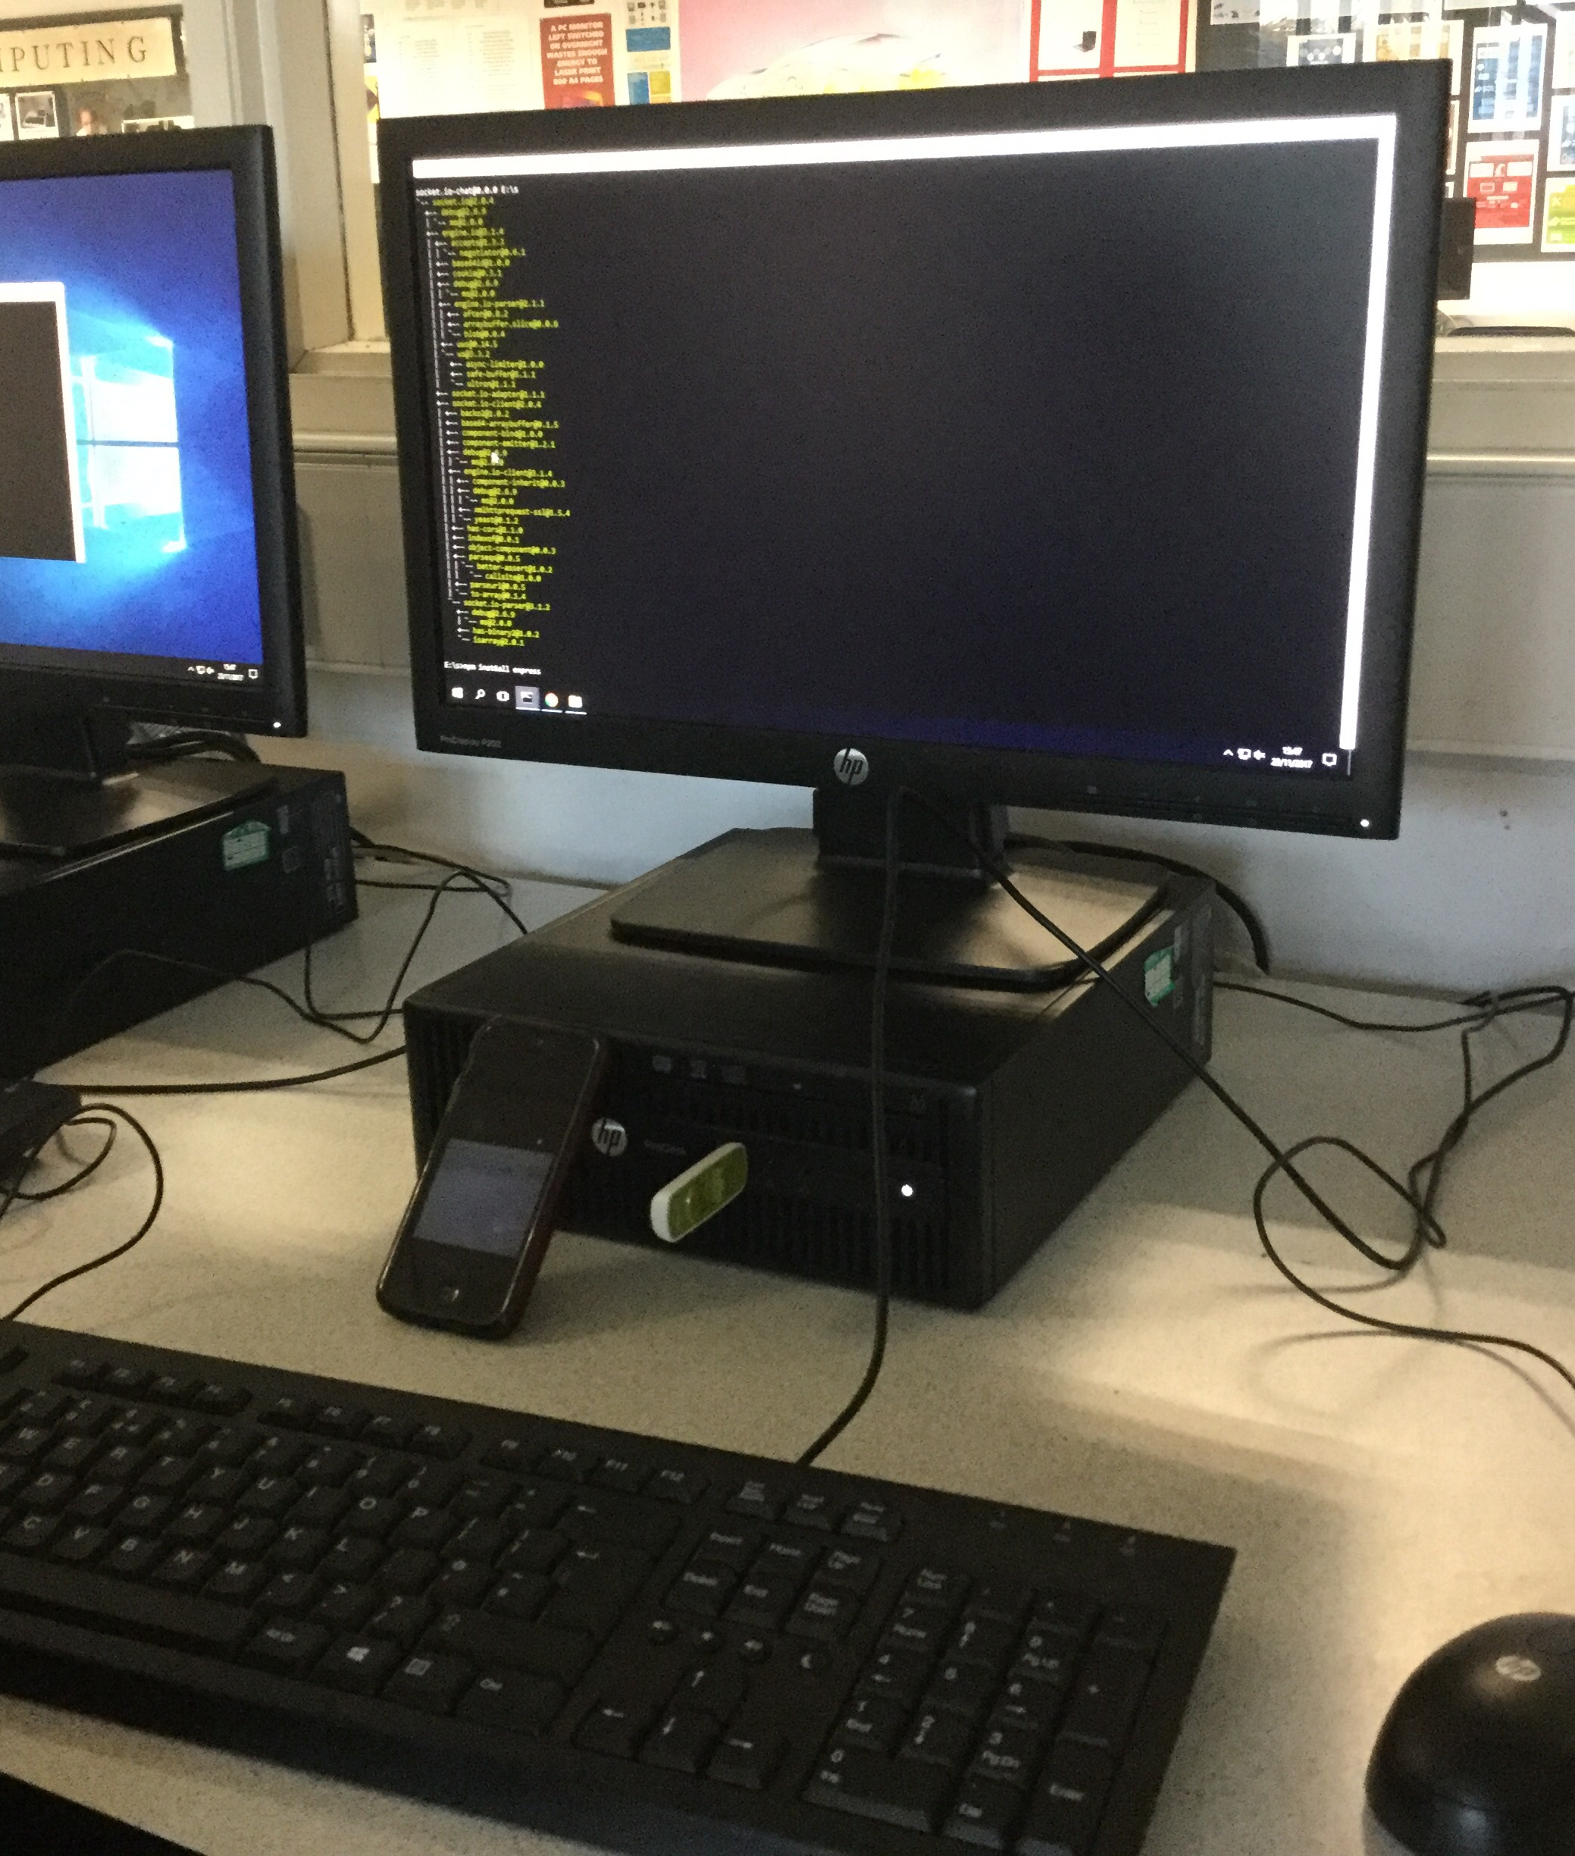
Our Solution
Our solution is to make our own Web app to promote the idea of saving water through showernode.

Slide 8
